Slide 1
Experiment three
The specific heat capacity of a poor conductor by the method of mixtures.
Aim:. To determine the specific heat capacity of a poor conductor

Slide 2
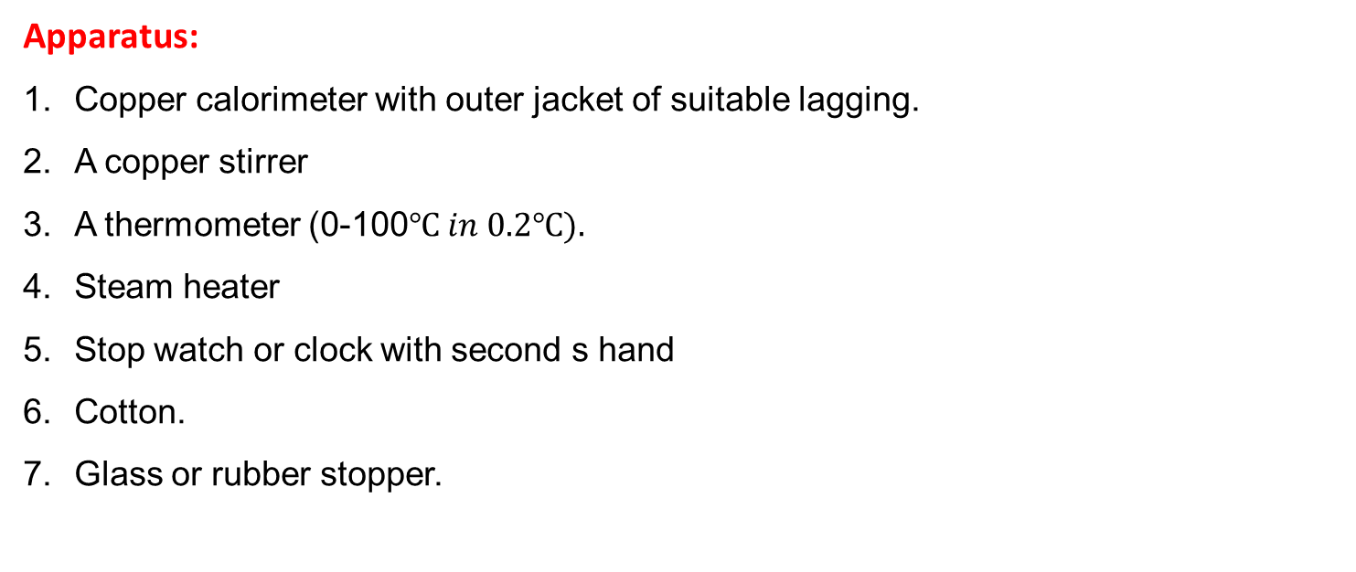
Apparatus:
Copper calorimeter with outer jacket of suitable lagging.
A copper stirrer
A thermometer (0-100$℃ in 0.2℃).$
Steam heater
Stop watch or clock with second s hand
Cotton.
Glass or rubber stopper.

Slide 3
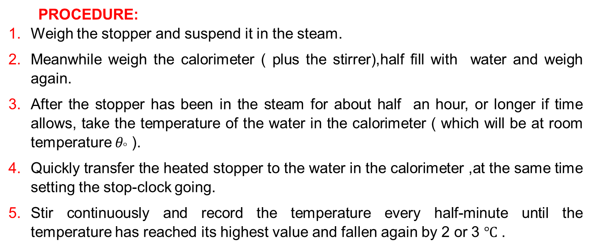
PROCEDURE:
Weigh the stopper and suspend it in the steam.
Meanwhile weigh the calorimeter ( plus the stirrer),half fill with water and weigh again.
After the stopper has been in the steam for about half an hour, or longer if time allows, take the temperature of the water in the calorimeter ( which will be at room temperature $θ_{°}$ ).
Quickly transfer the heated stopper to the water in the calorimeter ,at the same time setting the stop-clock going.
Stir continuously and record the temperature every half-minute until the temperature has reached its highest value and fallen again by 2 or 3 $℃$ .

